Slide 1

WPDD202: Webpage Design & Development
Version 2 – 18th December 2015

Slide 2
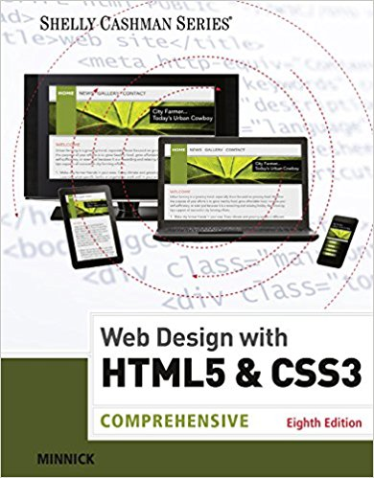
Resource Material
Web Design with HTML & CSS3: Comprehensive, 8th Edition
Jessica Minnick; Lisa Friedrichsen
ISBN-10: 1305578163 | ISBN-13: 9781305578166 © 2017
Cengage Learning Australia

Slide 3
Chapter 11
Publish and Promote a Website

Slide 4
Chapter Objectives
Describe search engines
Explain search engine optimization (SEO)
Create description meta tags
Describe a domain name
Describe a top-level domain
Explain the role of a web hosting service

Slide 5
Chapter Objectives (continued)
Describe a File Transfer Protocol (FTP) client
Connect to a remote server
Publish a website with an FTP client
Market a website
Register a URL with a search engine

Slide 6
Search Engines
Search engines are used to find specific businesses or content on the web
They are online tools that search for websites based on keywords entered by a user
They use robots (also known as bots or spiders), which are programs that run automated tasks on the Internet, to traverse the web in search of the keywords entered by users

Slide 7
Search Engines (continued)
As the robots browse the web, they index and organize their findings, which are stored in a database
The robots view and may store webpage titles, meta tag keywords and descriptions, and h1 or other heading element content
Popular search engines include Google.com, Bing.com, Ask.com, and Yahoo.com

Slide 8
Search Engine Optimization
Search engine optimization (SEO) is the process of improving the amount of traffic to a website by improving the ranking of the site in search engine results pages (SERPs)
Rank – It is the position of a webpage link, as displayed on the SERP
An impression is created each time a webpage link appears in a SERP of a related query

Slide 9
Search Engine Optimization (continued)
Effective SEO involves key tasks such as:
Brainstorming key words that describe the business
Using these keywords within the domain name, page titles, heading elements, and meta tags
Researching the competitors and noting their keywords
Optimizing images by using keywords within the alt text of the images as robots cannot read text on the images

Slide 10
Meta Tags
The meta tag name derives from the word, metadata, which is information about data
The statement below declares the character encoding as UTF-8
<meta charset=”utf-8”>
The Unicode Transformation Format (UTF) is a compressed format that allows computers to display and manipulate text

Slide 11
Meta Tags (continued 1)
Author, description, and keywords for the webpage are specified through the use of the name and content attributes
The name attribute identifies the type of information in the content attribute
The content attribute identifies the specific phrases or words that are required to appear as metadata

Slide 12
Meta Tags (continued 2)
The following is an example of a description meta tag:
<meta name="description" content="Forward Fitness Club is an elite fitness center dedicated to helping our clients achieve their fitness and nutrition goals.">
where description is the value for the name attribute

Slide 13
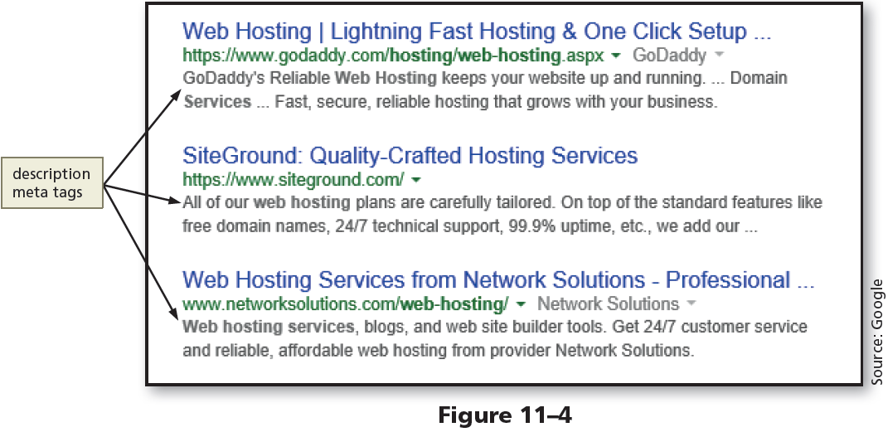
Meta Tags (continued 3)

Slide 14
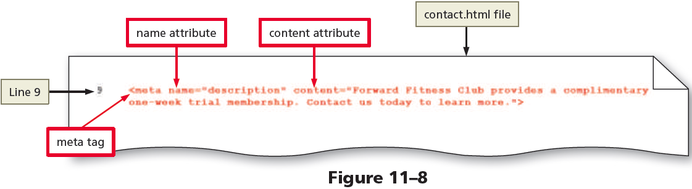
To Add a Description Meta Tag to a Webpage

Slide 15
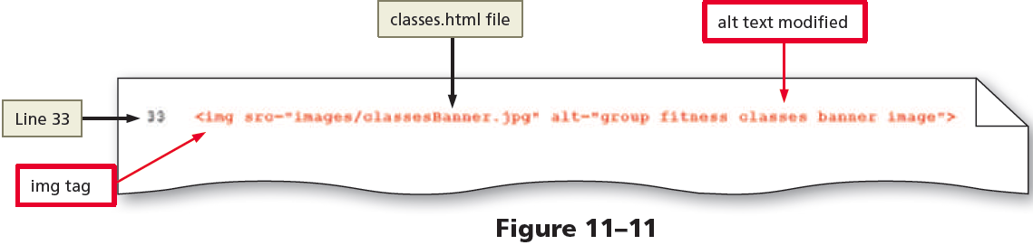
To Modify Alt Text on a Webpage

Slide 16
Domain Name
A domain name is the server name portion of a URL
One should select and register a domain name such that it represents his or her business
The .com top-level domain (TLD) name is preferred for businesses
An open TLD means that any person or entity can register with the domain name

Slide 17
Domain Name (continued 1)
To determine if the domain name considered is available, one can start the search at InterNIC, www.internic.net
InterNIC is a registered service mark of the U.S. Department of Commerce
The InterNIC website is operated by the Internet Corporation for Assigned Names and Numbers (ICANN) to provide information to the public regarding Internet domain name registration services

Slide 18
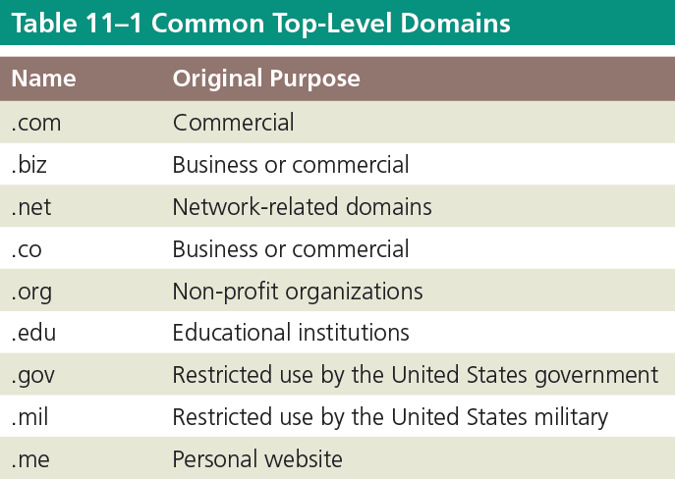
Domain Name (continued 2)

Slide 19
Website Hosting
Options to find a hosting service are:
using a company that charges for website hosting services
using the Internet service provider (ISP) that is used to connect to the Internet as a website host
using virtual web hosting, which is a less expensive option than ISPs, because payment need not be made to a dedicated server that hosts only one website
setting up and maintaining one’s own web server

Slide 20
Website Hosting (continued)
The following questions need to be answered once a web hosting service is selected:
What is the total cost?
How much space is available?
How fast is the connection speed?
How much total bandwidth transfer is available?
Is technical support provided?
Are tracking services provided?
After a web hosting service is selected, files need to be transferred to the host’s server

Slide 21
Publishing a Website
When a website is published, the website files are transferred to a web server
One way to upload files to a web server is to use a File Transfer Protocol (FTP) client program
An FTP client is a software that is used to transfer files from a computer to a server over the Internet

Slide 22
FTP Clients
Like other types of software, some FTP clients are free and some are for purchase
FileZilla is a free FTP option, available for download at filezilla-project.org
The FileZilla FTP client software is available for several OS platforms, including Windows, Mac, and Linux

Slide 23
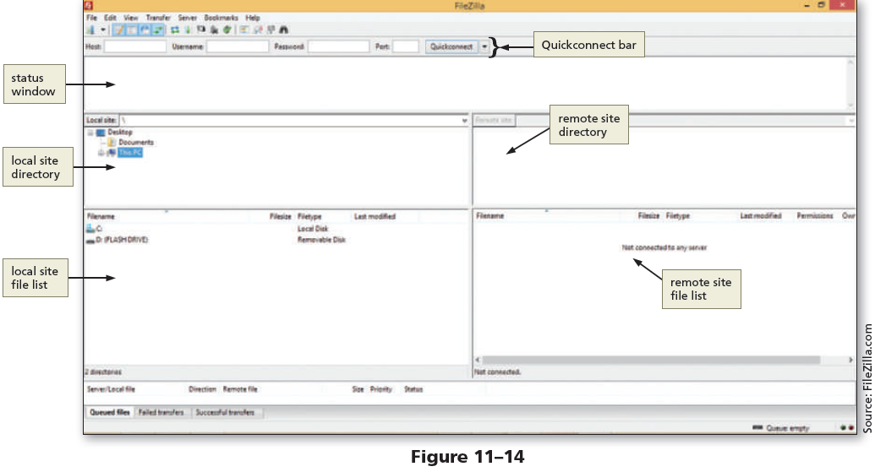
FTP Clients (continued 1)

Slide 24
FTP Clients (continued 2)
An FTP client is required to upload and publish website files and folders, unless a direct access to the web hosting server is available
If there is no preferred FTP client specified, it can be downloaded

Slide 25
Transferring Files
Pieces of information required to publish a website are:
URL or domain name
FTP username and password
port number

Slide 26
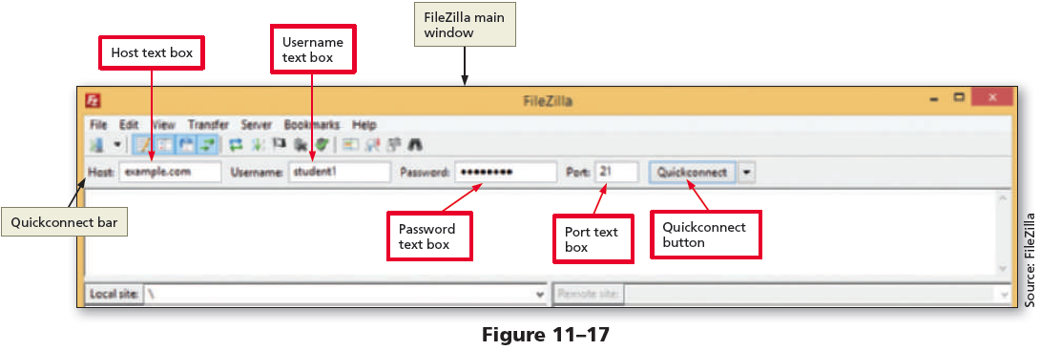
To Start FileZilla and Connect to a Remote Server
Before a website can be published, one must use an FTP client to connect to a remote web server

Slide 27
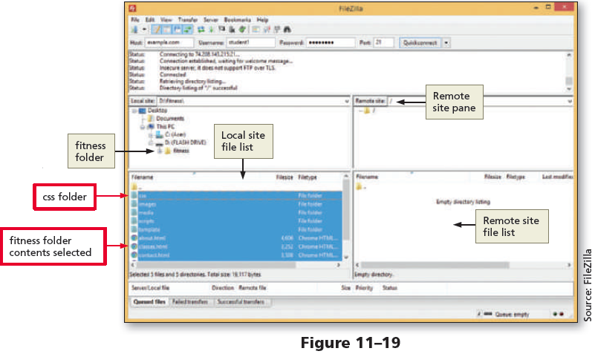
To Upload Folders and Files to a Remote Server

Slide 28
To View and Test a Published Website
After successfully publishing a website, view the website on a browser and test all the links
The following steps are used to view the published website in a browser:
Open a browser and type the website’s URL in the address bar to display the webpage
Tap or click the labels in the webpage that contain links to display the pages and to verify the page content

Slide 29
Marketing a Website
After testing webpages and correcting any errors, the last step is to market the website location to attract visitors
A website can be promoted and marketed to reach the targeted audience in the following ways:
Add the URL for one’s website to his or her business cards, company brochures, stationery, and email signature
Advertise the URL in newsletters and print articles

Slide 30
Marketing a Website (continued)
Tell about the website when one meets people
Find and get listed on targeted directories and search engines specific to one’s industry
Buy banner ads
Negotiate reciprocal links in which one agrees to link to a website if they agree to link to his or her website
Use newsgroups specific to one’s industry

Slide 31
Registering with Search Engines
A website is registered with a search engine after the meta tags are entered and the website is published and marketed
The two most popular search engines are Google and Yahoo!
It is also a good idea to register a website with search engines that specialize in subject matter related to the website

Slide 32
To Validate the HTML Files
Every time a new webpage is created or modified, run it through W3C’s validator to check the document for errors
Validation is an effective troubleshooting tool during the development process and adds a valuable level of professionalism to the work done

Slide 33

A Short Academic-Integrity Presentation
What do we mean when we say "academic integrity"?
What are the 3 main kinds of academic misconduct?
What happens when we break academic integrity rules?
Common problem #1: paraphrasing
Common problem #2: citations
Common problem #3: quoting too much
A quiz! Of course there's a quiz.

Slide 34
A Short Academic-Integrity Presentation
What do we mean when we say "academic integrity"?
Being honest in your dealings as a student
Being ethical
Maintaining the value of higher education
Maintaining the quality of courses and learning experiences

Slide 35

A Short Academic-Integrity Presentation
2. What are the 3 main kinds of academic misconduct?
Contract cheating – asking/paying another person to create all or parts of an assessment and saying that it’s your own.
Using other people’s work (especially that of published researchers) without quoting, citing, and/or referencing accurately. This is plagiarism.
Using other people’s work, but not changing it sufficiently (e.g. not paraphrasing completely). This is also plagiarism.

Slide 36



A Short Academic-Integrity Presentation
3. What happens when we break academic integrity rules?
The percentage of your assignment that is plagiarised will not be assessed (~ % penalty).
Zero for the assessment in serious cases.
3. Zero for the unit in more serious cases.

Slide 37
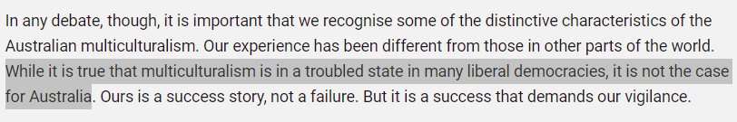
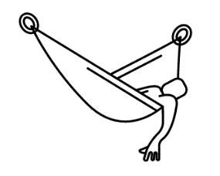


A Short Academic-Integrity Presentation
4. Common problem #1: lazy paraphrasing
Original:
Lazy
Studious
It is fact that multiculturalism is in a bad state in many countries, but it is not the situation in Australia (Australian Human Rights Commission 2016).
As the Australian Human Rights Commission (2016) points out, Australia does not have the problems with multiculturalism that many other liberal democracies have.
This is plagiarism

Slide 38
A Short Academic-Integrity Presentation
5. Common problem #2: citations
Author(s) family names
Space, no comma
Full stop after (not before)
(Taylor & Harrison 2016).
Parenthesis, no space before or after
Parenthesis, no space after
Year of publication

Slide 39
A Short Academic-Integrity Presentation
5. Common problem #2: citations for quotes
p, full stop, and a space
(Taylor & Harrison 2016, p. 11).
The page number
Comma and space

Slide 40
A Short Academic-Integrity Presentation
6. Common problem #3: quoting too much
According to the Australian Human Rights Commission (AHRC) (2016, p 16), ‘it is important that we recognise the some of the distinctive characteristics of Australian multiculturalism’. This is because ‘our experience has been different from those in other parts of the world’ (AHRC 2016, p 16). The AHRC (2016, p 16), claims that ‘ours is a success story, not a failure’, but that ‘it is a success story that demands our vigilance’.
Can you see the problem here?
Notes:
The problem here is that very little – basically none – of the discussion in this paragraph is original. The student hasn’t offered any insight, analysis, explanation, critique, exemplification or anything else that makes these ideas meaningful in the content of the assignment. Because so much of this is unoriginal, it can be seen as approaching plagiarism.

Slide 41

A Short Academic-Integrity Presentation
7. A quiz.
Link

Slide 42
A Short Academic-Integrity Presentation
Come and visit us at Academic Learning Support (ALS) for more help with academic integrity or any other learning matter.
Drop-in hours: 10AM-11AM and 2PM-3PM, Monday to Friday
ALS Melbourne
ZOOM: 713 695 7302
TEL: (03) 8353 0871
ALS Sydney
ZOOM 658 953 2737
TEL: (02) 9092 5171

Slide 43

kent.edu.au Kent Institute Australia Pty. Ltd. ABN 49 003 577 302 ● CRICOS Code: 00161E ● RTO Code: 90458 ● TEQSA Provider Number: PRV12051

